Slide 1
Sol
The Sun:
A Typical Star

Slide 2
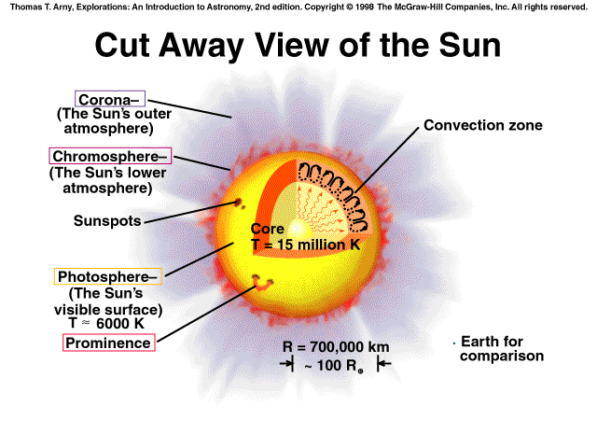

Slide 3
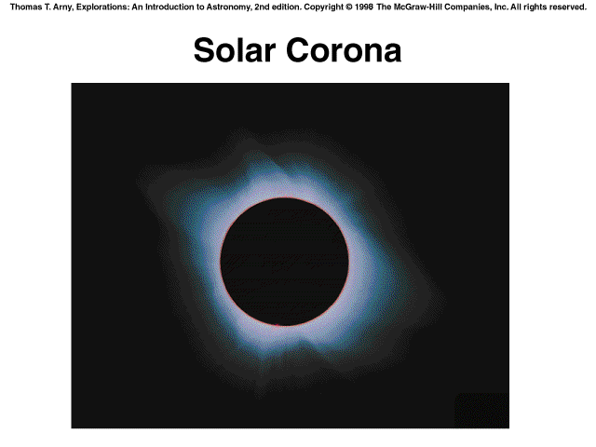

Slide 4
Basic Structure
Average Density = 1.4 g/cm³
94.3% Hydrogen
5.6% Helium
0.1% Metals
Surface Temperature = 5762 K
Core Temperature = 15,000,000 K

Slide 5
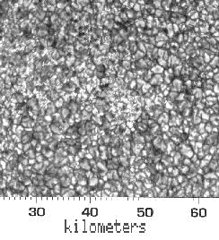
Basic Structure
Photosphere - "sphere of light", the visible surface of the Sun
Chromosphere - "sphere of color", visible during solar eclipses
Corona - the Sun's outermost atmosphere. The outflow of gas in this region is called the solar wind, which is protons and electrons that have escaped the Sun's gravity.

Slide 6
The solar interior

Slide 7
The Sun's Interior
Thermonuclear core - the central region of Sun where fusion takes place due to high temperatures and pressures.
Radiative zone - a region inside a star where energy is transported outward by the movement of photons.
Convective zone - a layer inside a star where energy is transported outward by means of heat flow through the gasses of the star (convection).

Slide 8
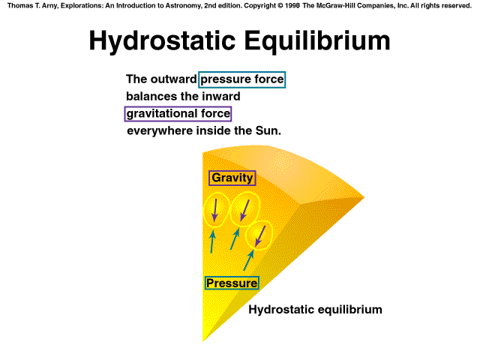

Slide 9
Hydrostatic Equilibrium
The outward pressure force balances the inward gravitational force everywhere inside the Sun.

Slide 10
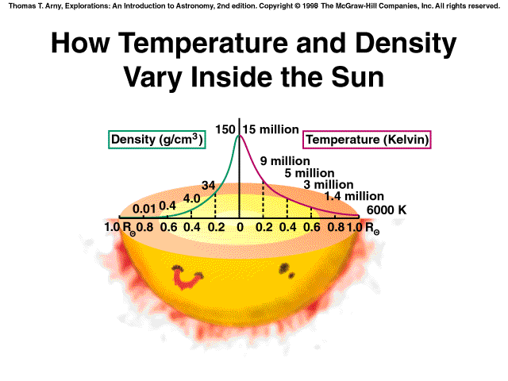

Slide 11
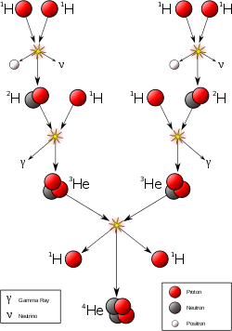
The proton-proton fusion reaction
Starts with energetic collisions between pairs of protons.
Intermediate products are deuterium (2H) and 3He.
End result:
4 1H → 4He + neutrinos + energy

Slide 12
The proton-proton fusion reaction con’t
Before reaching the atmosphere, photons generated in the core of the Sun, travel through the main body called it interior.
They travel a zigzag path on their way out, as they are scattered back and forth by particles (mostly electrons).

Slide 13
The proton-proton fusion reaction con’t
So many interactions occur, that it literally takes hundreds of thousands of years for a typical photon to travel from the center of Sun to the surface.
Another effect of the optical depth effect is limb darkening.

Slide 14
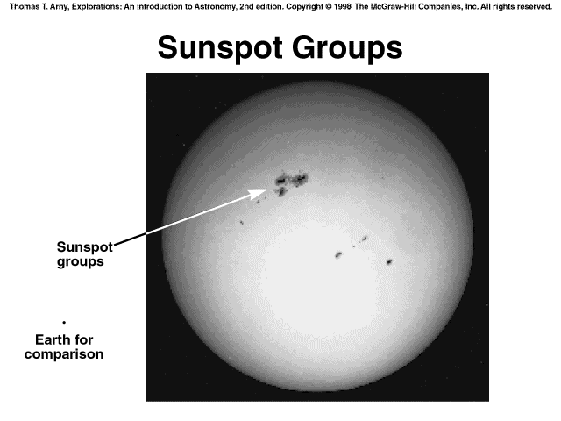

Slide 15
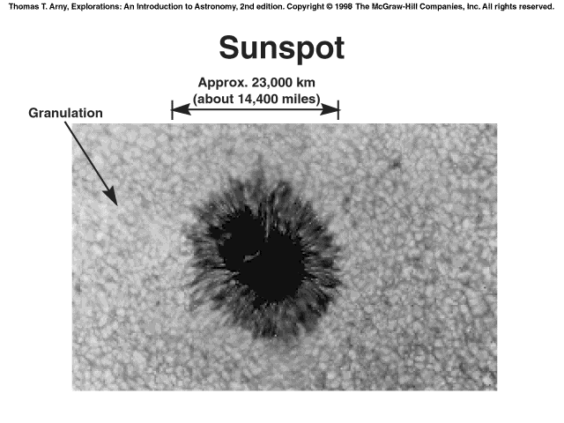

Slide 16
Surface Features
Granules - convection features about 1000 kilometers in diameter seen constantly in the solar photosphere.
Sunspot - a temporary cool region in the solar photosphere created by protruding magnetic fields.
A close-up of the sunspots shows that they have darker inner region (the umbra) surrounded by the lighter region (the penumbra).

Slide 17
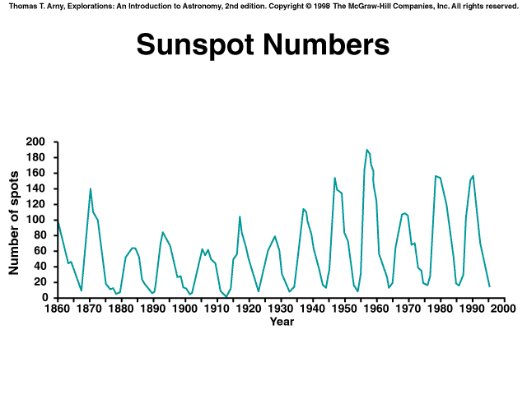

Slide 18
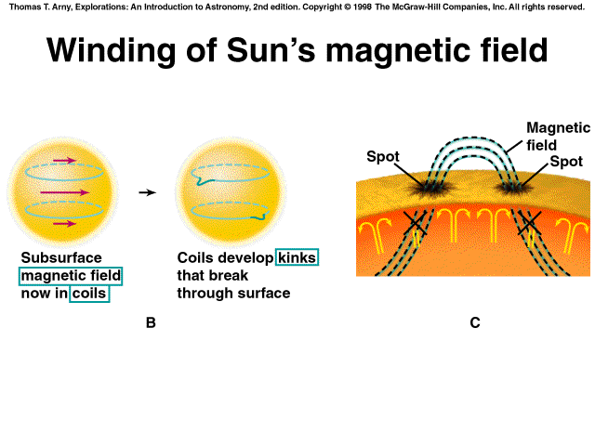

Slide 19
Solar Cycle
The rotation rate varies from once every 25 days to once every 30 days.
This differential rotation twists the magnetic field lines.
This causes the number of sunspots to vary over an 11 year period.
Maundar’s Butterfly Diagram shows a pattern when we plot the latitude of each sunspot as a function of time.

Slide 20
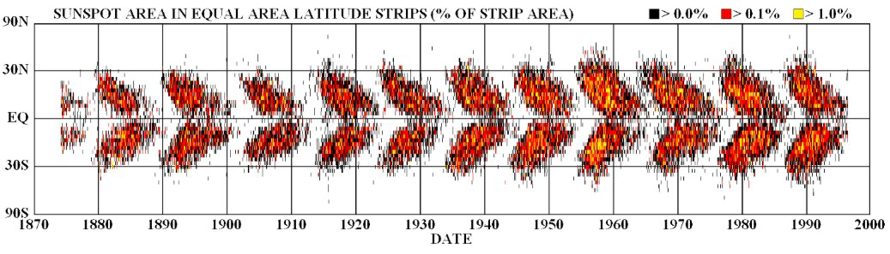

Slide 21
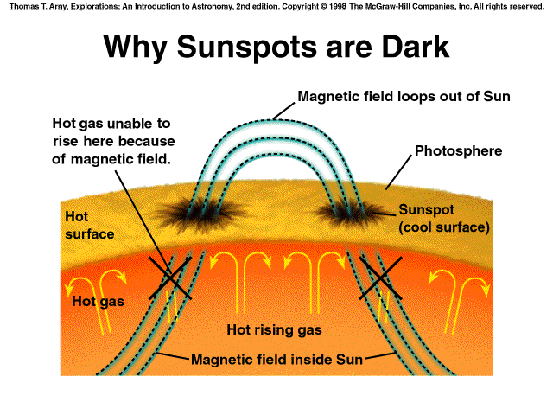

Slide 22
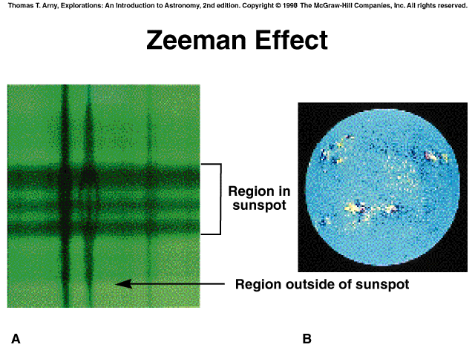

Slide 23
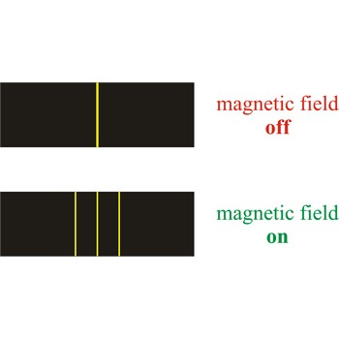
Solar Magnetic Fields
Zeeman Effect - the splitting of some of the spectral lines of a hydrogen gas into two or more components.

Slide 24
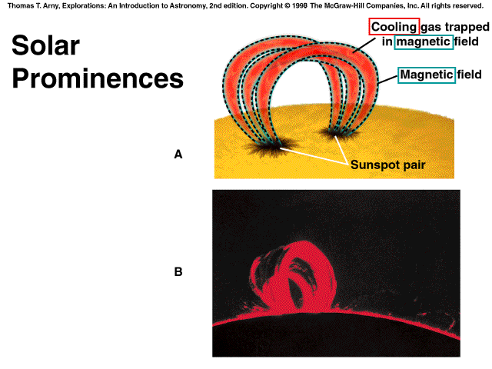

Slide 25
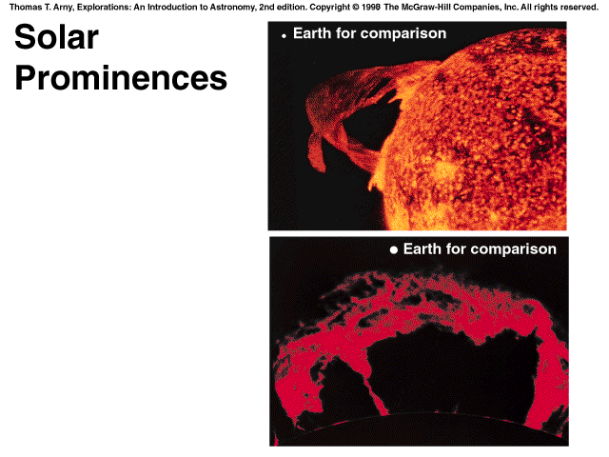

Slide 26
Solar Magnetic Fields
Prominence - a flamelike protrusion seen near the limb of the Sun and extending into the solar carona.
Auroras are caused by the solar wind.

Slide 27
What makes the Sun shine?
Thermonuclear fusion at the Sun's core is the source of the Sun's energy.

