Slide 1
The Expanding Universe and the big bang theory

Slide 2
Summary:
In this lesson, we cover what is arguably the most far-reaching discovery of 20th Century science: the expansion of space.
We’ll start off by discussing
(a) the evidence that led to this discovery.
(b) we’ll briefly cover Einstein’s explanation of the Hubble Law, before moving on to
(c) the wild controversy between the Big Bang and Steady State theories.
Finally, we’ll cover
(d) the observational data that (mostly) settled the controversy: the Microwave background.

Slide 3
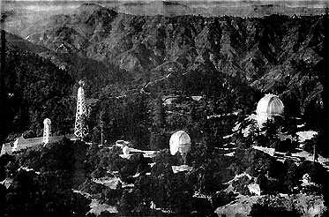
The Discovery that Space is Expanding
Our story starts in the 1920s. American astronomer Edwin Hubble was measuring spectra of distant galaxies, using the 100” Hooker Telescope at Mt Wilson observatory, high on a mountain overlooking Los Angeles.
The spectra of most stars and galaxies show emission and absorption lines at particular well-known wavelengths. If you see an emission or absorption line at (for example) 372.7 nm wavelength, you know that ionised oxygen is present, while a line at 486.1 nm tells you that the thing you are looking at contains hydrogen.

Slide 4
So imagine his surprise when the spectra showed vast numbers of absorption and emission lines, but all at strange wavelengths!
Could these galaxies be full of bizarre chemical elements producing lines at unfamiliar wavelengths? Galaxies made of lanthanum, yttrium etc, rather than old familiar carbon and hydrogen?
Perhaps the laws of physics were different in these far off galaxies, so familiar elements emit and absorb light at strange and unusual wavelengths?
Things were getting pretty desperate when he noticed a vital clue in his data...

Slide 5
The vital clue:
The spectra of the distant galaxies had all the same features as the spectra of nearby galaxies: just shifted to longer wavelengths!

Slide 6
The Mystery of Redshift
This was the discovery of redshift (as discussed in the Module on Estimating Extra-Galactic Distances). It led to one of the strangest and most remarkable graphs ever plotted: the Hubble Diagram.
Hubble measured the redshift in each of his galaxies. He defined the redshift z as the change in the wavelength of some feature, divided by its normal wavelength : ie.

Slide 7
The remarkable graph:
symbol
The redshift of a galaxy correlates with its distance: the further away it is, the higher its redshift. This is called the Hubble Law.

Slide 8
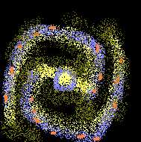
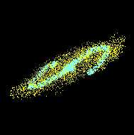
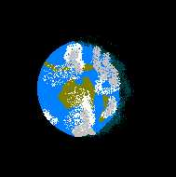
Earth

Slide 9
What is going on?
Lots of theories were put forward:
Perhaps the laws of physics are just different far away? That does something funny to the spectra so all the light comes out with a longer wavelength than it should.
Perhaps everything in the Universe is running away from us! The Doppler effect means that something running from us would appear to have a redshifted spectrum.
Perhaps something funny happens to light that travels a long way to reach us.
All pretty far fetched: but we need something to explain the Hubble Law: click on any of these to explore the options.

Slide 10
Something happens to the light en route
Believe it or not, this is actually the generally believed theory. Something strange is believed to happen to the light, during its long journey between the distant galaxy and the Earth. Sounds just as implausible as the other explanations, but it has one advantage:
Einstein predicted it.
Well, actually he didn’t. His General Theory of Relativity says that space is far more than the empty bits between matter. It has a life of its own, and amongst other things, it can actually expand.

Slide 11
When Einstein applied his equations to the whole Universe, he found something that didn’t seem to make sense: the only solutions he could find had the Universe either expanding or shrinking: he couldn’t get it to stand still.
‘Obvious nonsense!’ he thought to himself, and promptly invented a magical fudge-factor called the cosmological constant, for the sole purpose of allowing the Universe to stand still. He later called this his greatest mistake.
Then, ten years later, along came Hubble with his strange data, and everyone realized that this could be explained very nicely by Einstein’s original calculations! If Einstein hadn’t been so cautious, he could have predicted the Hubble law.

Slide 12
What does it mean for space to expand?
The green grid-lines represent space itself: stars indicate matter
Space expands, carrying stars, galaxies and everything else along for the ride
Every bit of empty space is constantly growing.

Slide 13
So: space itself is expanding. As it expands, it carries stars and galaxies along for the ride. An analogy may help:
Take a fruit loaf before it has been baked. The bits of fruit represent galaxies, and the dough is space.
If there were microscopic astronomers on one of the bits of fruit, they might exclaim:
The expanding universe is like putting the loaf in an oven: the dough expands, carrying the pieces of fruit away from each other.

Slide 14
But what has this got to do with the Hubble Law?
Space is expanding pretty slowly. If you cross 1 km of space on the way to work, you’d have to wait thirteen million years before the expansion of space enlarges your walk by one metre.
The light from a distant galaxy, however, may have been travelling millions or even billions of years before it hits your telescope and is detected. During that long flight, space will have grown substantially. This stretches the photon of light, increasing the wavelength.

Slide 15
So this is Einstein’s explanation of the Hubble Law. Space is slowly expanding, and any photon that’s flying through space on its way to our telescopes will be stretched as it flies. The longer it’s been flying, the more it will be stretched: that’s why redshift correlates with distance.
But hold on a moment; if space is expanding, perhaps our telescopes, spectrographs, rulers, indeed our bodies are also expanding to match? If absolutely everything expands by the same amount, could we even tell the difference?
It turns out that this is not what relativity predicts. The space between the atoms in our bodies is indeed expanding. Our atoms, however, are held together by chemical bonds: when the expansion of space pulls atoms apart, these chemical bonds just pull them back together again.

Slide 16
The Great Controversy: Steady State versus the Big Bang.
So: space is expanding. This has been generally conceded since the 1920s. Far more controversial were the implications of this for the history of the universe.
If space were expanding, then the density of the universe must be dropping: you only have a certain amount of matter and it is being spread over greater and greater regions of space. We must be living in a unique time: never before and never again will the universe have its current density. Far in the future, space will have expanded so much that we may not even be able to see other galaxies.

Slide 17
Far in the past, space would have been much smaller than it is now: all the galaxies we see today must have been squashed up together. And if you extrapolate the universe far enough back, all the stars and galaxies we see today must have been squashed together into some sort of primordial fireball.
Many astronomers didn’t like this idea (Sir Fred Hoyle contemptuously called it the ‘Big Bang’ theory and the name stuck). It offended their sense of philosophical rightness for the universe to be changing, that we live in a unique moment, and that if we look back far enough every atom in the universe must have been squashed together.
These astronomers came up with a rival theory: the ‘Steady State Theory’.

Slide 18
The Big Bang Theory
The amount of matter (yellow stars) in the universe is fixed.
As space expands, the existing matter just gets spread over a larger volume
The density of matter in the universe thus goes down in the Big Bang Theory. Every galaxy gets further and further from its neighbours as time passes.

Slide 19
The Steady State Theory
As space expands, new matter keeps on appearing (the blue stars), filling in the increasing gaps between older matter (yellow stars).
Thus the density of matter doesn’t change: the universe always looks the same, containing a mix of old and new matter.
This universe has no beginning and no end.

Slide 20
Testing the Theories.
Which of these theories is true? For decades the debate raged. Did the universe have a definite beginning or has it always existed, unchanging? The issues go far beyond science: philosophers, poets and theologians all became involved.
Is there any observable evidence that could allow us to discriminate between these theories? In principle, yes. If the Big Bang theory is true, the universe should be changing: the universe a billion years in the past should be different from the universe today. If, on the other hand, the Steady State Theory was true, the universe should be ageless: always looking the same.

Slide 21
So: the test of the theories is to measure whether the universe is changing. But how can we do this? You’d think we would need a time machine to see what the universe looked like in the past.
Luckily for astronomers, we can see into the past. We can do this because light travels so pathetically slowly (a mere 300,000 km/s) . Whenever we see something in space, we are seeing it not as it is now, but as it was some time in the past, when the light set out on its long journey towards the Earth. For example, light takes 1.5 seconds to reach us from the Moon: when we see the moon, we are seeing it as it was 1.5 seconds in the past. We see Alpha Centauri as it was 4 years in the past, Beta Centauri as it was 400 years ago.

Slide 22
Looking into the Past
Because the light emitted in the distant past is only now arriving at the Earth.

Slide 23
In principle, we thus have an excellent way of testing the two rival theories: look at very distant parts of the universe. By doing this we are looking back in time. If the Steady State Theory is correct, no matter how far back we look, the universe should appear much as it does now. If, however, the Big Bang Theory were true, as we look out to increasing distances, we should be seeing the universe as it was when it was younger, with a higher density and younger stars and galaxies.
(A caveat: we are assuming that all bits of the universe are basically alike. We cannot see what our own galaxy looked like long ago, so we are hoping that the distant galaxies we can see are basically similar to local galaxies, only seen when the universe was younger).

Slide 24
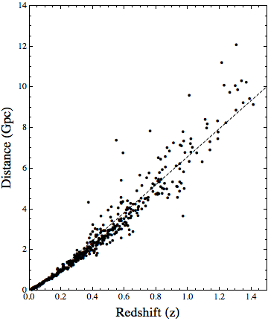

Slide 25
Looking Deep in Space
By the mid 1950’s, both rival teams of astronomers had realized that the way to test their theories was to study the universe at enormous distances and see whether it looked different from the universe today. The race was on.
With the technology of the times, it was not possible to see galaxies at sufficient distances using optical telescopes. For a decade or more, the battlefield was therefore radio astronomy.
Quasars and other active galactic nuclei are the most powerful things in the universe. Even with 1960s technology, they could easily be seen out to enormous distances.

Slide 26
Quasars
“Quasi-Stellar Radio Sources” = Quasar
A quasar can be up to 1000 times brighter than its host galaxy.
Though quasars are rare today, they were relatively common in the past (several billion years ago).
Statistics indicate that quasars must shine for hundreds of millions of years.
Quasars vary in brightness over time periods as short as weeks; this implies that they are quite small.

Slide 27
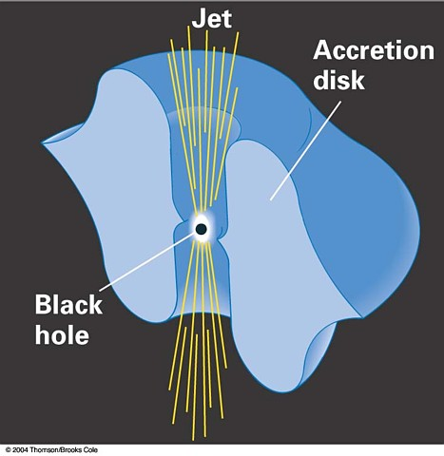
Theoretical Model of a Quasar
Matter falls toward a black hole, gathers into a spinning disk of hot gas, converting gravitational energy to thermal energy. Just outside the horizon, pressures are so high that some material is forced out into a jet at near light speed.

Slide 28
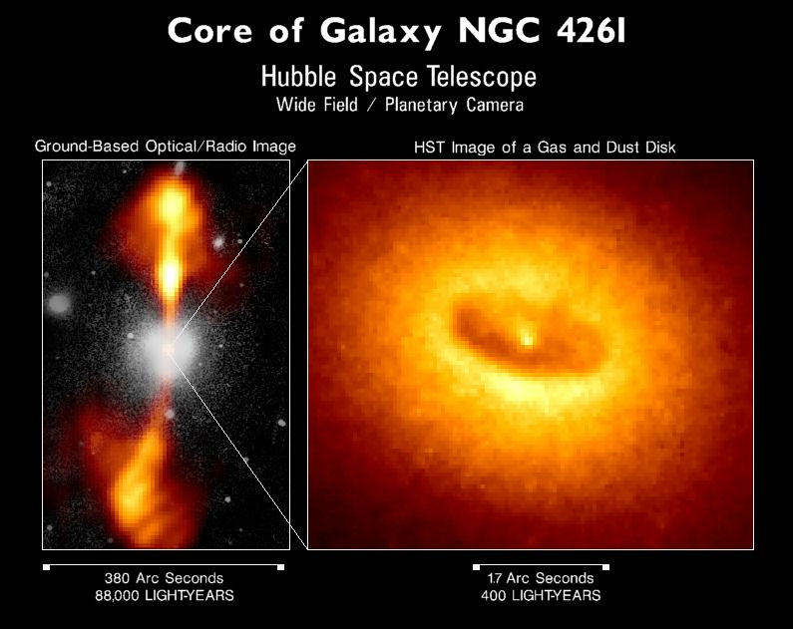

Slide 29
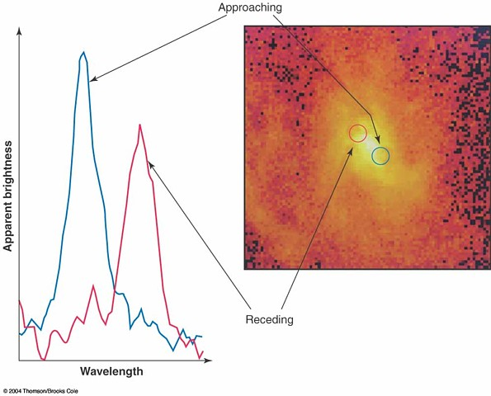
Testing the Theory
Stars near centers of all large galaxies (including our own) are orbiting VERY fast. Central masses vary from about 1 million to 1 billion solar masses.

Slide 30
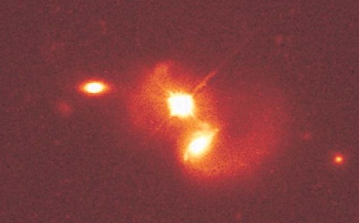
Why are quasars rare today?
Eventually they suck up all the nearby gas and run out of fuel.
Stars slightly farther out are in stable orbits; they rarely collide to send material toward the black hole.
But if another galaxy should happen to stray through, its material could reignite the quasar!

Slide 31
Competing Cosmologies
“Big Bang”: 10 - 20 billion years ago the universe was much more dense than today (and therefore hot and unpleasant).
“Steady State”: As galaxies move apart from each other, new atoms are spontaneously created in empty space. These atoms coalesce to form new galaxies. The average density of the universe doesn’t change over time. There was no hot early universe.

Slide 32
Competing Cosmologies
“Big Bang”: 10 - 20 billion years ago the universe was much more dense than today (and therefore hot and unpleasant).
“Steady State”: As galaxies move apart from each other, new atoms are spontaneously created in empty space. These atoms coalesce to form new galaxies. The average density of the universe doesn’t change over time. There was no hot early universe.
Quasars were the first evidence that the universe was much different in the past than it is today.

Slide 33
Quasar Evolution:
As we discussed earlier in this course, the quasar population evolves. We see more than a thousand times as many quasars per unit volume in the early universe as we see today.
So the distant universe is NOT like the nearby universe: surely evidence against the Steady State Theory?

Slide 34
The proponents of the Big Bang Theory certainly thought that they’d won the argument. Many of the Steady State supporters were forced to agree. But the data (back in the 1960’s) was ratty, and nobody really understood what quasars were, so many remained unconvinced (a few still are).
But then came the surprise: an almost completely unexpected discovery, made using a bizarre new technique.
The Microwave Background Radiation.
It was discovered in 1963 by Arno Penzias and Robert Wilson, a couple of microwave engineers working for Bell Labs.

Slide 35
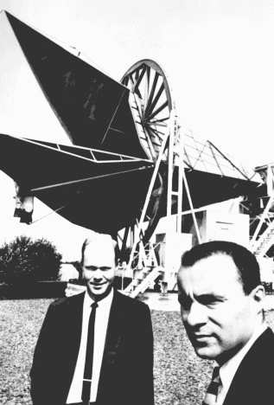
They had built a bizarre horn-shaped antennae: a form of radio telescope sensitive to radio waves of higher frequencies than most telescopes at the time could detect.
They were planning to use it to study radio emission from the Milky Way (back then companies sometimes supported pure research).
As they worked, they kept finding a strange extra signal, which remained constant regardless of where on the sky they were pointing their telescope!

Slide 36
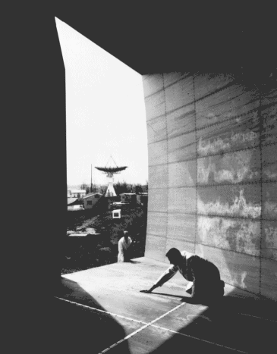
At first they thought that the signal was coming from pigeon droppings inside the antennae. Many hours were devoted to cleaning it out.
Eventually they realized that this extra radiation was coming from space: an incredibly uniform glow of microwaves coming from every direction!
Cleaning the Antenna
This was the microwave background, and its discovery won Penzias and Wilson the Nobel prize: one of the rare occasions on which someone went looking for dirt and found gold!

Slide 37
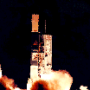
The Microwave Background
What Penzias and Wilson had detected, and many other researchers subsequently confirmed, was a microwave glow coming from all parts of the sky. The best data on this microwave background currently comes from the COBE satellite.

Slide 38
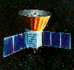
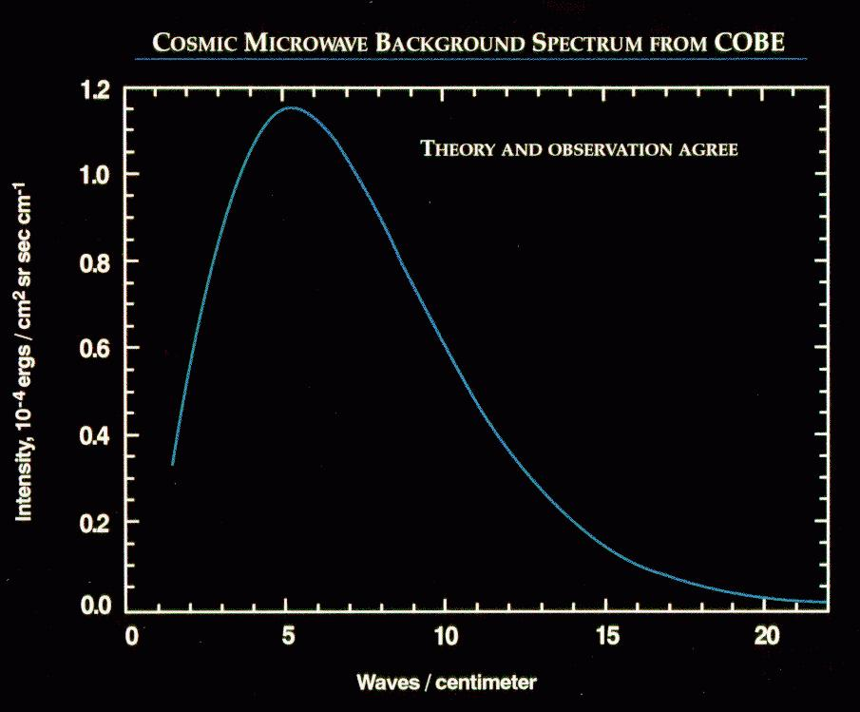
What did COBE see?:
COBE contained instruments designed to map the microwave background, and to measure its spectrum with an accuracy that that would have been impossible from the ground.
The microwave background had precisely the spectrum you’d expect of an opaque object at a temperature of 2.7 K.
This plot actually includes both data and theory: they agree so closely that you cannot tell them apart!

Slide 39
Where was the radiation coming from?:
Even more remarkable: the amount of radiation coming from all parts of the sky was fantastically uniform. The (orange) picture shows the raw data: virtually uniform emission coming from everywhere.
If you look at these data in more detail, subtracting off effects such as the motion of the Sun and microwave emission from the Milky Way, you find that the microwave background is not perfectly uniform. But it’s pretty close!

Slide 40
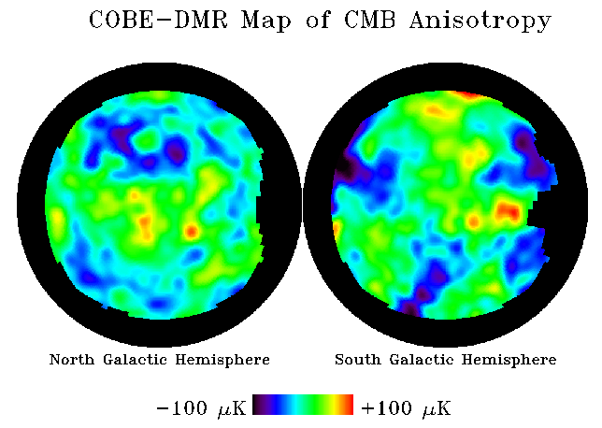
Here is the final COBE map of the temperature of whatever is producing the microwave background. This graph plots differences in temperature from one part of the sky to another: notice how tiny they are (less than 100 micro K).

Slide 41
So where is this microwave background coming from?
Strangely enough, this radiation is exactly what the Big Bang theory predicts!
Remember: in the Big Bang Theory, space expands but the amount of matter remains constant. That means that if we look back into the past, everything must have been squeezed closer together.
What happens when you squash something? It gets hot: just think of pumping up a bike type: as the air is compressed it gets so hot that the connector hose can be too hot to touch.

Slide 42
Background Microwave Radiation
Just after the Big Bang the universe would have been so hot and dense that it would have looked like a glowing fog.
As it expanded, it cooled, until the gas was no longer glowing. The photons of light from the glow (blue arrows in the picture) were still flying around.
As the universe expanded further, planets and stars formed. Most of the photons emitted when the universe was a glowing fog are still flying around, slowly being stretched to longer wavelengths as the universe expands.
Even today, the Earth is being bombarded from all sides by these photons: this is the microwave background!

Slide 43
The Answer?
This was the end of the Steady State Theory. The microwave background was strong evidence that once, long ago, the universe was so dense and hot that it glowed. This was quite inconsistent with the steady state picture of an ageless, unchanging universe.
Needless to say, a few people disagree. They believe that the microwave background is caused by some other process (decaying ultraviolet photons?). However, the vast majority of astronomers now accept that the universe is changing with time. In the next few activities we’ll learn about how it has changed and why.

Slide 44
Summary
In this lesson, we’ve learned than space itself seems to be expanding. As it expands, it carries galaxies along for the ride, and stretches the wavelengths of any photons flying though space.
We’ve also learned that the universe seems to be changing: it was much hotter and denser in the past. Indeed, we are still detecting the glow from when the universe was hot: the microwave background radiation.

Slide 45
So: the universe was once filled with a uniform fog of glowing gas. How did it turn into the familiar universe of stars and galaxies? This is our topic for the next few lessons.

Slide 46
