Slide 1
Quantum Mechanical Model of the Atom
Mr. Tsigaridis

Slide 2
Bohr-Rutherford Model of the Atom
Neils Bohr’s experiment that showed us that the electrons around an atom can exist only at specific energy levels had a fundamental flaw
It only could explain the emission spectrum for the hydrogen atom
If you look at the emission spectrum for other elements, there are far more spectral lines than that of hydrogen (ex. Iron)

Slide 3
Spectral Lines
The reason that the number of spectral lines increases so drastically is that the number of electrons in the atoms increases
The scientists had to reconsider the energy level ideas
They made a leap of faith and they came up with a hypothesis that shook the scientific community and that was there must be more energy levels within the other energy levels (sub levels)

Slide 4
Quantum Theory
To begin to understand the structure of the atom we must start to talk about and to understand one of the most important and fundamental theories in science
It is a theory that is all around us, it underpins much of the technology that we take for granted and yet retains its reputation for obscure difficulty and bizarre predictions

Slide 5
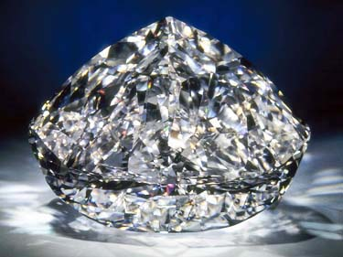
Quantum Theory
I want you to picture a large diamond, like this one
It is worth well over a million dollars and is one of the hardest known substances in the universe
It is so expensive because it is so rare and so beautiful

Slide 6
Quantum Theory
It is a much different type of beauty, it is more profound and its beauty can be explained through quantum theory and quantum mechanics
Diamonds are some of the hardest known substances on the planet which is why they are used so often industrially, and yet light can stream right through it relatively unimpeded

Slide 7
Quantum Theory
This begs the question, how can something be so ethereal and yet be so hard that it can drill through solid rock
To answer this we must delve deeper into the diamond to its inner structure
This will not only answer how the diamond is put together, but how all of matter in the universe from the smallest grain of sand to the largest bodies in the universe are put together

Slide 8
Quantum Theory
The best theory that we have to discuss all of this is quantum theory
Quantum theory is quite odd, it says odd things like things can be in multiple places at once, and it says that the subatomic building blocks of our bodies are constantly shifting and changing relative to the world around us
It describes the world around us with better precision than the theories of physics laid out by Sir Isaac Newton

Slide 9
Quantum Theory
The one thing that sets quantum theory apart from other theories is that it can be tested and each time that it is, it agrees with observations

Slide 10
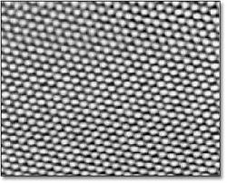
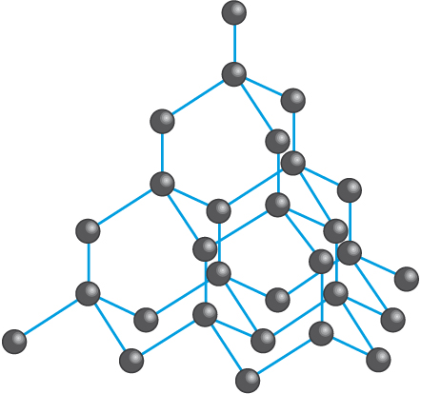
Into the Heart of a Diamond
This is a picture taken with an electron microscope of the atoms that make up a diamond

Slide 11
Into the Heart of a Diamond
What you can see is carbon atoms surrounded by four other carbon atoms in a regular and predictable crystalline structure
In the large diamonds that I showed you in the above pictures, there is something like 3,000,000,000,000,000,000,000,000 atoms
They are all laid our in that precise structure that you see
The 3D conformation that you see there is the tightest that carbon atoms can be packed together

Slide 12
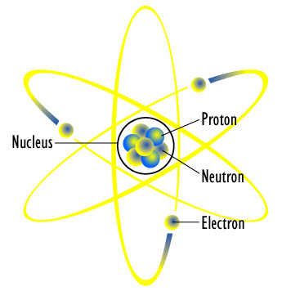
Into the Heart of a Diamond
It is this 3D conformation of the atoms arranged in the crystalline structure that gives diamond its hardness
The interesting thing is even though diamond is so hard, the majority of the space in the diamond is empty space
Recall Rutherford’s experiment from last class

Slide 13
Michael Faraday
Atoms are held together by a force that was described by Michael Faraday that says that the positive nuclear force of the nucleus holds the electrons to the nucleus because they are both electrically charged and oppositely charged

Slide 14
Electrons Behaviour
One of the strange things in quantum theory is the behavior of electrons in an atom
These imperceptibly small particles spend the vast majority of their lives in electron clouds that are found somewhere far from the nucleus
In fact, if I was a nucleus of an atom standing in this classroom, the closest electrons would be somewhere on the beaches of Toronto harbour
The important thing here to remember is that atoms are vast and they are empty about 99.9999999999999% empty space

Slide 15
Electrons Behaviour
So if you are buying a diamond or a car or something very expensive remember that your buying stuff that is mainly empty space
If I were to squeeze all the space out of all the atoms in all the people of the world, I would be able to fit the entire of humanity in an area the size of an eraser on the top of your pencils
Understanding why atoms are so empty and yet so solid, or why light can stream through that diamond is a prerequisite to studying everything in nature

Slide 16
Electron Behaviour – Double Slit
There is one classic experiment that can then help us understand why things in the world of an atom behave in such strange ways
It is known as Thomas Young’s double slit experiment
Time to think with your neighbour, if you had a bunch of particles, and they were going through 2 slits and being caught on the other side, what would you see on the other side?

Slide 17
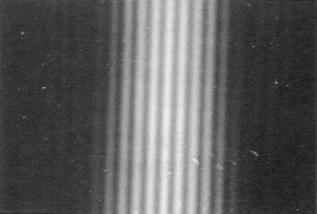
Electron Behaviour – Double Slit
You would expect that beneath each slit, there would be a pile of sand
The reason for this is that particles fall through slits in a very predictable way
However, when this was done with electrons which are supposed to be particles, the following picture was discovered

Slide 18
Electron Behaviour – Double Slit
What about a different version of the same experiment, instead of using sand particles, discuss with your neighbour what you think you would see if it was water waves being pushed through 2 slits
Video 1 – Young’s Double Slit Wave Tank

Slide 19
Electron Behaviour – Double Slit
The inference that can be made from seeing the second experiment is that the waves are acting more like waves rather than particles
The double slit experiment reveals something fundamental about electrons and that is that sometimes they behave like particles but experiment tells us that sometimes they behave like waves
This point is the key to help us understand the emptiness of atoms

Slide 20
The Emptiness of Atoms
Continuing with the idea that electrons are particles and that those particles can sometimes act as waves, we have to try another experiment together

Slide 21
Standing Waves
You will notice that as they vibrate the string that it vibrates in a very particular way
The wave is trapped or confined by the two people oscillating the spring
There is only one part of the wave that is moving with the maximum amplitude
This wave that is trapped is called a standing wave and it is called that because it is confined and not moving like you would picture a wave

Slide 22
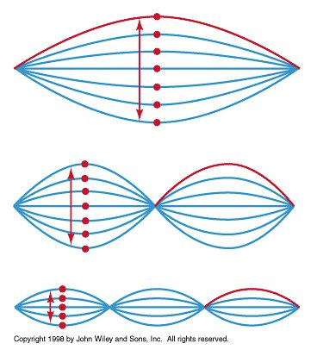
Standing Waves
The second wave that you notice has more energy inputted into it and you can see that now there are two parts of the spring that have the maximum amplitude and three stationary points

Slide 23
Standing Waves and Atoms
Just as the waves that you saw are trapped between the two points, electrons are trapped inside atoms
The positive electric charge of the nucleus effectively traps the negatively charged electrons in an atom sized box
When the electron is trapped, just as the spring was trapped, it exhibits those wave like patterns

Slide 24
Standing Waves and Atoms
A standing wave like this can have 0,1,2, or any integer number of wavelengths around the circle, but it cannot have a non-integer number of wavelengths like 8.3
In quantum mechanics, angular momentum is quantized for the same reason

Slide 25
Standing Electron Waves
Standing electron waves as they have been coined represent wave with different energies
Just as more energy had to be inputted to cause the standing waves with the spring, so to do electron standing waves represent different energy levels inside an atom
They also represent specific energies that they can have electrons can have, notice the waves only existed when a specific amount of energy was present

Slide 26
Standing Electron Waves
Scientists can measure the amount of energy that represents each standing wave and also the size of the wavelenght
The lowest energy wave has been measured to have a wavelength of 0.0000000003m
That is very small but compared to the nucleus it is massive, about 250,000 times larger
The nucleus of the helium atom is about 0.000000000000001m or 1fm

Slide 27
Standing Electron Waves
This explains why atoms are so big and so empty
It is because electrons trapped around the nucleus act as waves, in this case standing waves and there has to be enough room to fit an electron wave around the atomic nucleus

Slide 28
Another Question
But that brings up another questions, it does answer why atoms are so empty but we have not shown why they become so tightly bound together that they can create solid objects like the diamond that we were have been talking about
If you can answer that, you can explain the structure of everything that we see in the universe

Slide 29
A Boy Wonder’s Science
When quantum theory was first being invented, it was dominated by “boy wonders” people that were not much older than any of you sitting in front of me
The key discovery was made by a man named Wolfgang Pauli
He published his first paper on Einsteins theory of relativity when he was 18 years old
His contribution to quantum theory was made when he was only 24 years old

Slide 30
Pauli Exclusion Principle
We have seen so far that electrons are constrained in an atom sized box around a nucleus and that they can exist at only certain energy levels based on the fixed standing waves
Pauli realized that not all the electrons in an atom can occupy the lowest energy levels
Much like you can not all sit in the front rows of the class, there simply is not enough space for you

Slide 31
Pauli Exclusion Principle
To a physicist however this seems quite odd because according to physics everything wants to be in the lowest possible energy state
If I lift an object, that is, I apply work to it, as soon as I am not supporting it anymore it falls to the ground
The explanation is that the apple is falling into a lower energy state

Slide 32
Pauli Exclusion Principle
The surprising thing is that electrons do not follow these same laws and they do not fall down to the lowest energy state
It turns out that they are not allowed to come down to the lowest energy level by an unbreakable law of nature
It is called the Pauli exclusion principle

Slide 33
Pauli Exclusion Principle
As I mentioned before, electrons like you sitting here fill up the available seats in the class, starting from the lowest energy onwards
Now, this may sound meaningless or abstract, but it isn’t, it is profoundly important, in fact, it is the key to understanding chemistry

Slide 34
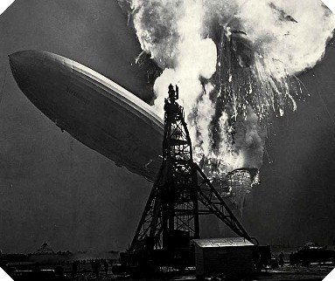
Pauli Exclusion Principle
Imagine the combustion of hydrogen gas, what is happening during that combustion?
By giving them a kick of energy (spark/flame) you are encouraging the hydrogen atoms in the gas to react with the oxygen that is in the air

Slide 35
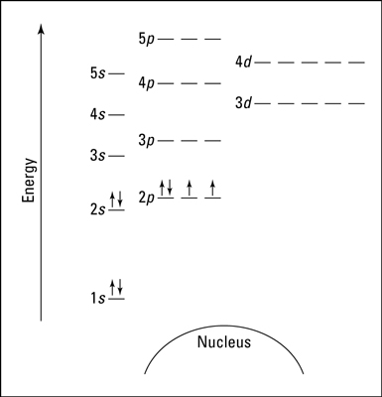
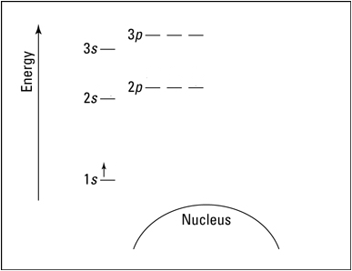
Pauli Exclusion Principle
Oxygen Hydrogen

Slide 36
Reactions with Pauli
Because oxygen has two unfilled energy levels and three completely filled energy levels, it is quite a hoarder or consumer of electrons
You have learned since grade nine that it would like to fill its orbitals completely
Hydrogen on the other hand does not mind sharing its electrons as it would also like to fill its orbitals considering it only has one electron in a half filled orbital

Slide 37
Pauli Exclusion Principle
Oxygen Hydrogen

Slide 38
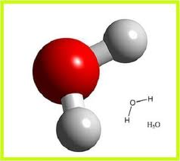
Pauli Exclusion Principle
There are two openings so two hydrogens need to react as shown above
When the reaction happened there was a flash, or a release of energy
That release of energy happened because the electrons in the hydrogen and the oxygen reconfigure much like the object reconfigured its energy down to the ground when it was dropped
Without Paulis Exclusion Principle, we would not have chemistry

Slide 39
Pauli Exclusion Principle
Without Pauli’s Exclusion Principle all the electrons would crowd down and there would be no chemistry
And without chemistry you wouldn’t have any magnificent structures in the universe like water, diamonds, or indeed any of you

Slide 40
Pauli’s Exclusion Principle
Another consequence of the exclusion principle was not proved until 1967
Pauli’s Principle says that identical electrons can’t occupy the same energy level
This also means that electrons will avoid each other at all costs and that proved the actual reason why I don’t fall through the empty atoms that the floor is made up of
And that is also what gives the illusion of solidity to the empty world of atoms

Slide 41
Richard Feynman – Double Slit
Let’s now travel back to the double slit experiment for an even deeper understanding of the wavy sub-atomic world
This time, instead of just showing you the pattern, I am going to show how that patter builds up
Remember that we are firing electrons at two slits, and seeing what happens when they are detected on the other side
Video 2 – Double Slit Quantum Mechanics

Slide 42
Richard Feynman – Double Slit
The video that you just saw was one electron at a time
That poses a much bigger problem that you might think at first
When we did it with the water and saw the pattern that it produced was due to the fact that when the waves interacted with one another, they cancelled each other out after interfering
What do you think is the problem with the last video?

Slide 43
Richard Feynman – Double Slit
The problem is that the electrons in the video are being fired out one at a time
They can not be interfering with other electrons

Slide 44
Richard Feynman – Double Slit

Slide 45
Richard Feynman – Double Slit
We have just seen that electrons have to be able to interfere with themselves because there are parts of the screen where no electrons appear and because of the evidence that we just saw we know that Feynman was correct.
He came up with a mathematical equation that summed up all the possible paths that an electron can take to get from one point to another called the Feynman Path Integral

Slide 46
Feynman Equation
All the Paths
Path probability of an electron
Sum Up

Slide 47
Feynman Equation
It sums up all the paths and spits out the probability that an electron will move from one point to another
It applies to everything from the larges bodies in the universe to the atoms that make up you and of course the atoms that make up the diamond that we talked about at the beginning of the presentation

Slide 48
Feynman Equation
Imagine now taking that giant diamond, and putting it into a box about 5cmx5cmx5cm
Feynman’s version of quantum theory tells us something rather shocking, the diamond is made up of atoms and the atoms are behaving according to quantum theory
Or to better put it, according to Feynman’s Equation

Slide 49
Feynman Equation
In other words, they are all currently exploring the universe
And that means the diamond must be doing the same thing because it is made up of atoms
And that means that there is a finite chance that if I were to open this imaginary box that the diamond will not be there
The diamond could jump out of the box on its own accord without anyone or anything touching it

Slide 50
Feynman Equation
Time that would be reasonable to wait for that to happen
Planck’s Constant
6.626x10⁻³⁴ Kg m² /s
Distance you want the object to move
Size of the Box
Mass if the Object

Slide 51
Feynman Equation
If you were to take the size of the box and input all the numbers into the equation, we would find that the time that it takes that object to jump out of that 5cm box is older than the age of the universe
The point of that is that quantum theory does not just apply to the inconceivably small, but rather to the inconceivably large as well
The reason we do not see the quantum effects is the size of Planck’s constant

Slide 52
Feynman Equation
However, at the atomic level, the box and distances become very small, so small that the time that it takes for these quantum effects to be observed is much less

Slide 53
Heisenberg Uncertainty Principle
Feynman’s equation also says that the more we know the position of something, like the diamond in the box, the more likely it is for the diamond to jump out of the box
This is known as Heisenberg’s uncertainty principle named after Werner Heisenberg

Slide 54
Heisenberg Uncertainty Principle
It says the more that you try to pinpoint the position of something, by trapping it in a smaller and smaller box, the more likely it is to jump around
It also says that the more precisely you know a particles position, the less certain you can be about its momentum

Slide 55
Heisenberg Uncertainty Principle
The reason that you can know one rather than the other is because of this
Say that you have measured the momentum of the particle and you know its mass and the force that was applied to it and for how long that force was applied for
When you go to re-measure for its location, you are effectively applying a force from the light particle bouncing off that particle (light is a photon made of particles)
And so by measuring both you are changing both
Heisenberg says that every measurement destroys part of our knowledge of previous measurements

Slide 56
Quantum Theory
Quantum theory, as I have shown you, has the ability to explain the unimaginably small world of atoms and we see the effects in the macroscopic world
The Diamond in the picture was 296-carats
BPM-37093 – Diamond Star
10000000000000000000000000000000000carats
We understand in detail why such a thing can exist and we and it are all intimately connected

Slide 57
The End

