Slide 1
The Muscular System
Miss Ulrich

Slide 2
Interesting Facts
Muscle cells cannot partially contract. They act on the ‘all or none’ principle. They either contract 100% or do not contract at all.
You cannot turn fat into muscle by exercising.
You cannot ‘spot reduce’ i.e. you cannot get rid of your spare tire by doing sit-ups.

Slide 3
When you are cold, your muscles produce rapid contractions to generate body heat (shivering).
A cramp is a painful muscle contraction.

Slide 4
Tetanus is a very severe type of contraction. It is a persistent contraction that can be caused by a bacterial infection. Sometimes you get a ‘tetanus shot’ to prevent this. Tetanus can cause lockjaw.
A spasm is rapid involuntary contraction of a muscle. You may have had one in your eye before - tick.

Slide 5
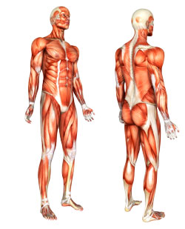

Slide 6
Movement
You are always moving. Even when you are sleeping, your muscles are working. Movement only stops when life stops.
Movement within cells is caused by chemical reactions. All other body movements are caused by muscles.

Slide 7
You have more than 650 muscles.
Muscles make up 40% of your body mass.
Muscles work by contracting. When a muscle contracts it shortens. Without your muscles, your bones could not move. When a muscle contracts it pulls on a bone, producing movement. Muscles can only pull bone; they cannot push bones.

Slide 8
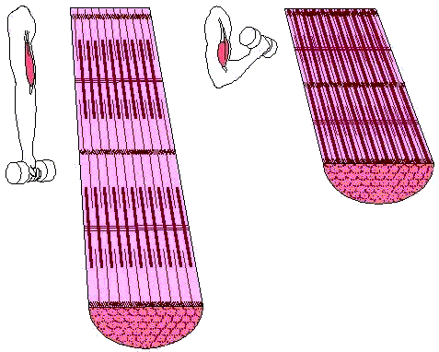
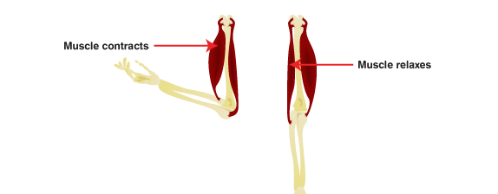

Slide 9
Structure of Skeletal Muscle:
Connective Tissue Covering
Epimysium
  Surrounds entire muscle
Perimysium
  Surrounds bundles of muscle fibers
    Fascicles
Endomysium
  Surrounds individual muscle fibers

Slide 10
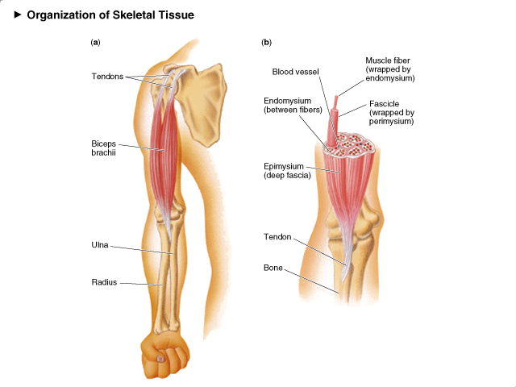

Slide 11
Structure of Skeletal Muscle:
Microstructure
Sarcolemma
  Muscle cell membrane
Myofibrils
  Threadlike strands within muscle fibers
  Actin (thin filament)
    Troponin
    Tropomyosin
  Myosin (thick filament)

Slide 12
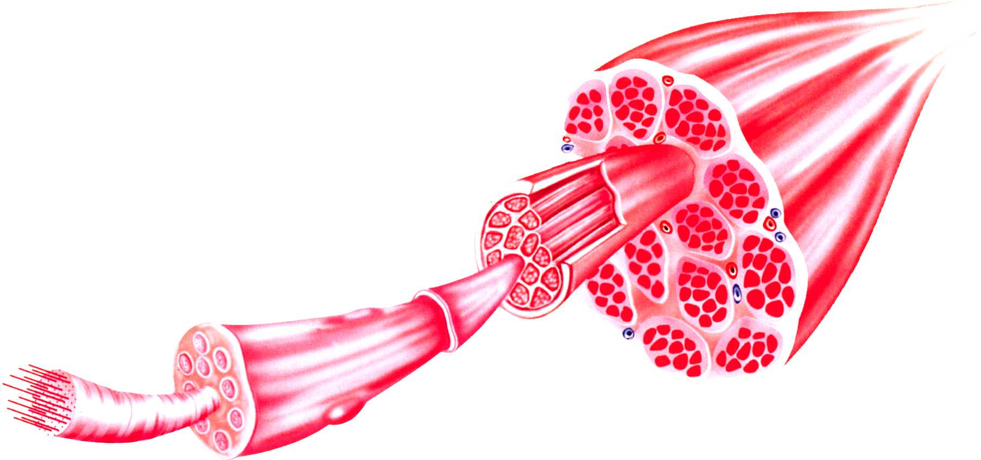
d) myofibril c) muscle fibre b) muscle fibre bundle a) Muscle belly

Slide 13
Muscle Fibres
Cylinder-shaped cells that make up skeletal muscle
Each fibre is made up of a number of myofilaments
Diameter of fibre (0.05-0.10 mm)
Length of fibre (appr. 15 cm)
Surrounded by a connective tissue sheath called Sarcolemma
Many fibres are enclosed by connective tissue sheath Perimycium to form bundle of fibres
Each fibre contains contractile machinery and cell organelles
Activated through impulses via motor end plate
Group of fibres activated via same nerve: motor unit
Each fibre has capillaries that supply nutrients and eliminate waste

Slide 14
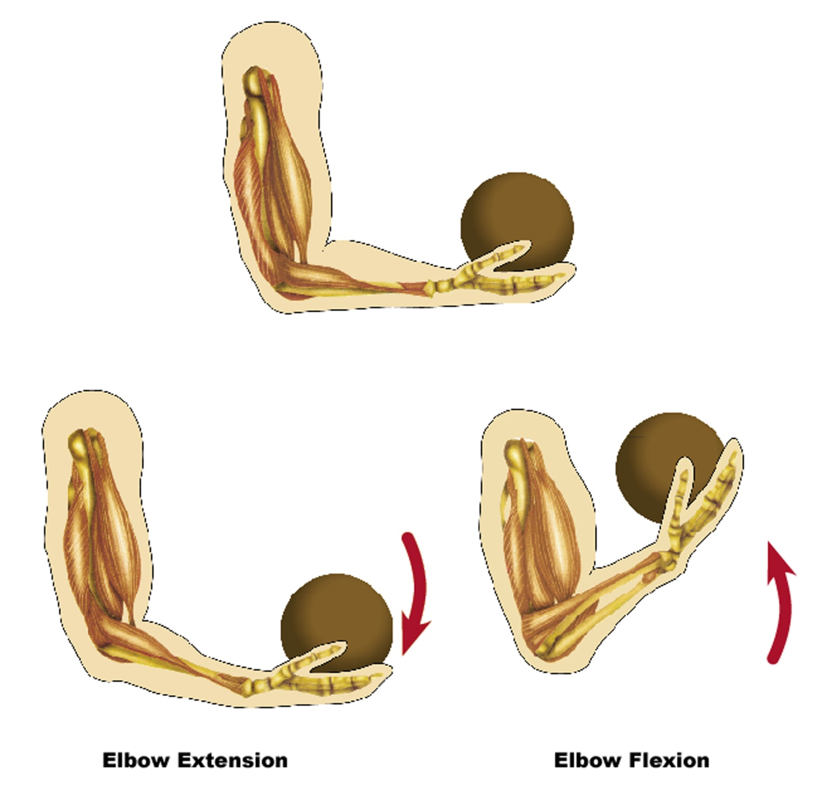

Slide 15
Types of Muscles
Not all our muscles are used for locomotion. Some allow us to wink, swallow etc. There are three main types of muscles. At the cellular level they all have the same function – to contract. When we move beyond the cellular level we see differences in their functions:

Slide 16
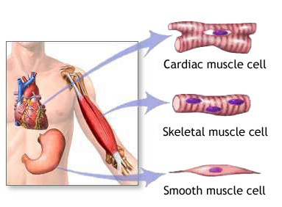

Slide 17
Type 1: Skeletal Muscle
Muscles that move your arms and legs
These are the ones that you control – they move when you want them to
They are attached to bone
Often called voluntary muscles
Under a microscope they look striped or striated so they are called striated muscles

Slide 18
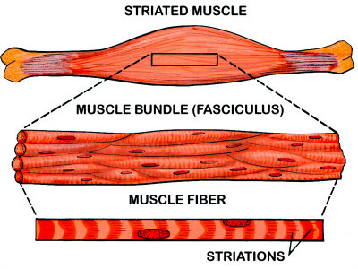
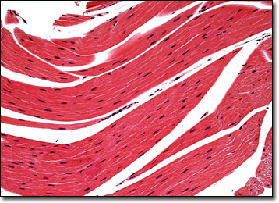

Slide 19
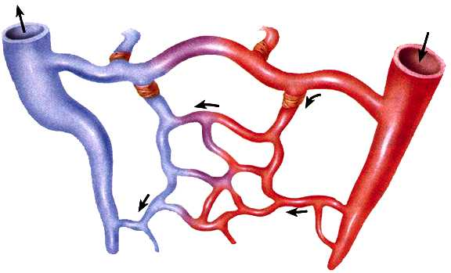
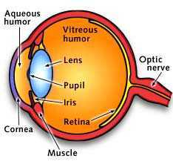
Type 2: Smooth Muscle
Often called involuntary muscles because you cannot control them
These muscles form the wall of most of the digestive tract; they are also found in blood vessels and other internal organs
Under a microscope they look smooth

Slide 20
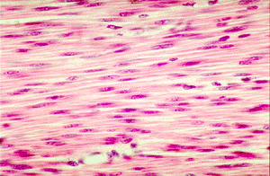
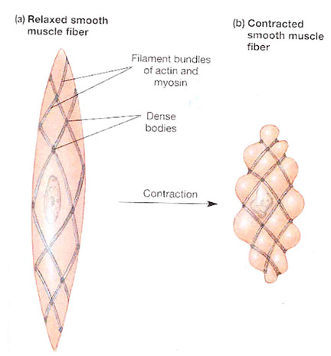
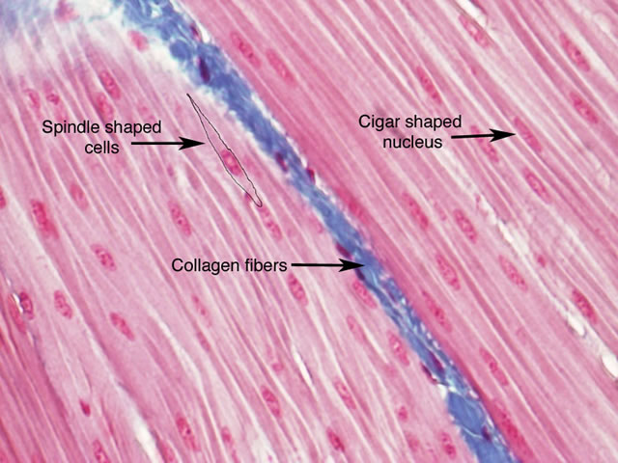

Slide 21
Type 3: Cardiac Muscle
This is the heart muscle
Under a microscope, cardiac muscle appears striated like voluntary muscles BUT cardiac muscle is involuntary – you have no control over your cardiac muscle
Fatigue resistant
Functions to provide the contractile activity of the heart

Slide 22
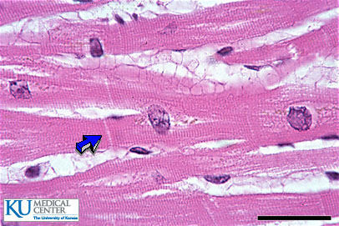
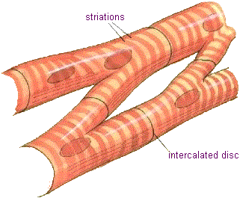
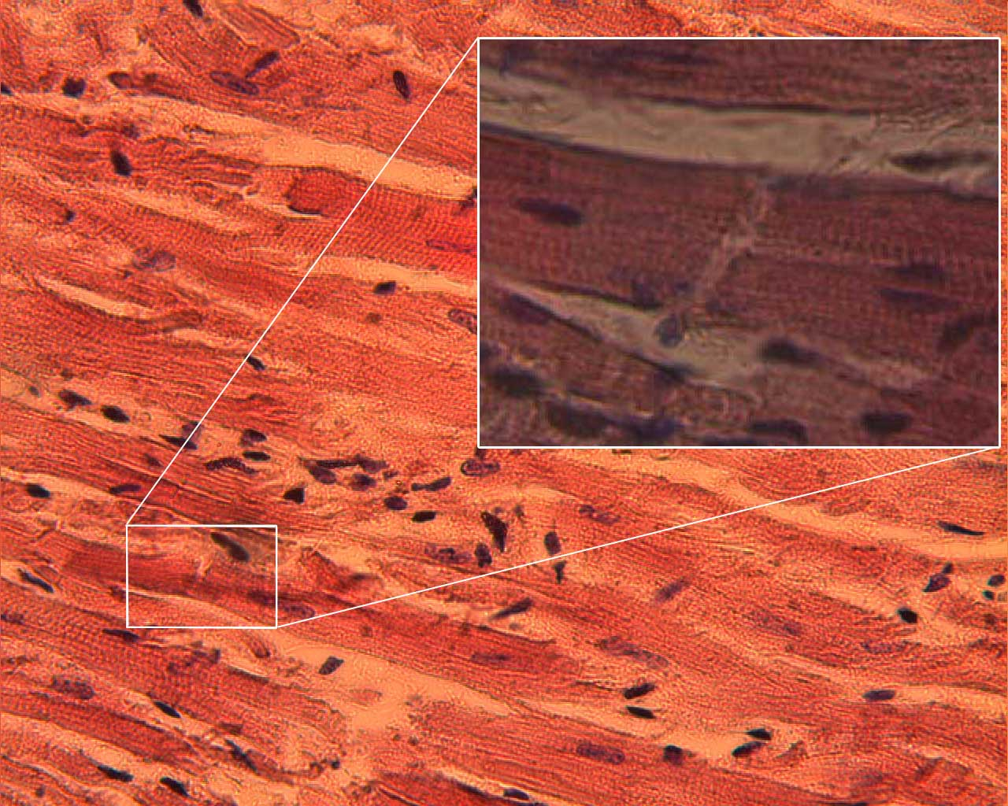

Slide 23
Muscle Attachment
For one bone to move toward another bone, a muscle is needed. This muscle will have 2 points of attachment
Origin: The place at which a muscle is attached to the stationary (not moving) bone
Insertion: The place at which a muscle is attached to the movable bone

Slide 24
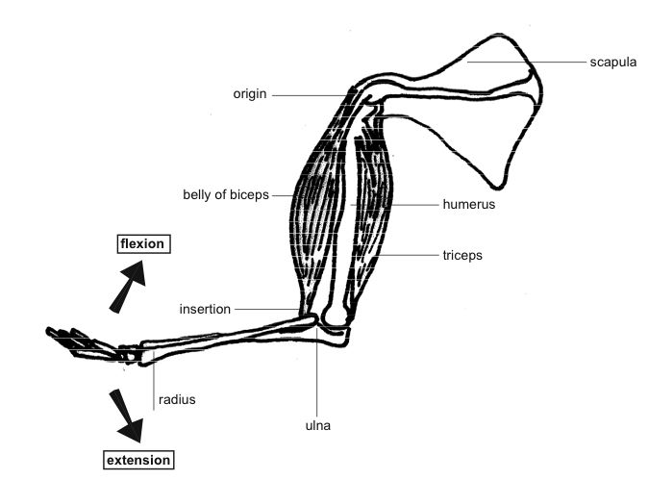

Slide 25
Muscles are attached to bones by tendons.
Tendons are tough, inelastic bands of connective tissue – they are very strong
A tendon is the thickness of a pencil and can support a load of several thousand kilos

Slide 26
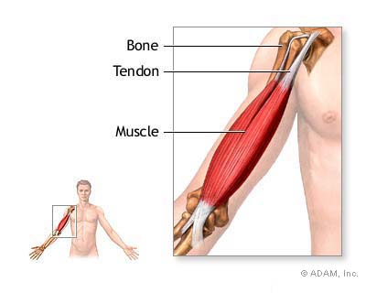

Slide 27
As the tendons are small, they can pass in groups over a joint or attach to very small areas for the muscle itself to find room for attachment
Although they are very tough, they are subject to wear and tear as they rub across bone surface

Slide 28
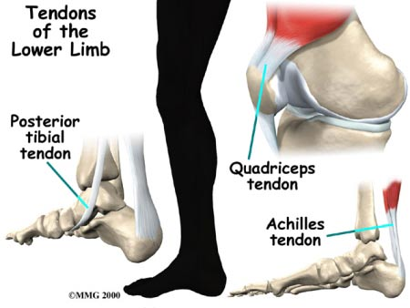
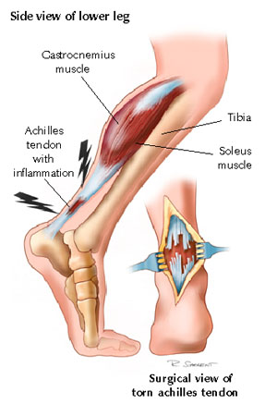

Slide 29
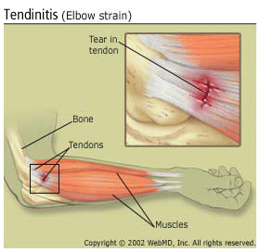
Tendons may become inflamed (tendonitis) when athletes work out in cold weather without adequate warm clothing, or without doing warm ups

Slide 30
Antagonistic Muscle Pairs
Many muscles act in pairs
This is necessary since a muscle can only pull by contracting
When a bone moves, movement in the opposite direct can occur only if there is another muscle that can pull the bone in that direction
These muscles are called antagonistic pairs

Slide 31
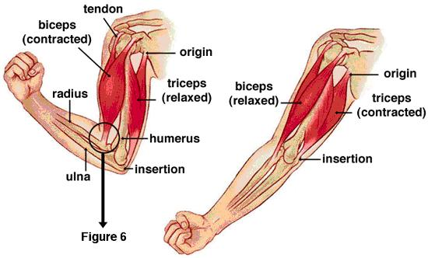

Slide 32
Exercise
There are two types of exercise:
Type 1: Isotonic Exercise
  Results in movement
  Ex) running, lifting weights etc

Slide 33
Type 2: Isometric Exercise
Muscles are pitted against each other
This is exercise that does NOT result in movement
Ex) Pushing a wall; hooking fingers together and trying to pull hands apart
Such exercises have been shown to increase strength and muscle size rapidly

Slide 34
Movement in Joints
Abduction: movement away from the side of the trunk or midline of the body Ex) raising arms to the side; swinging leg to the side
Adduction: movement toward the trunk or midline (opposite of abduction)

Slide 35
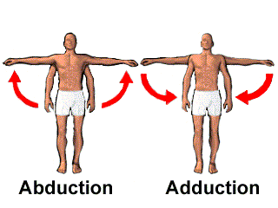

Slide 36
Flexion: bending or bringing bones together Ex) bending elbow or knee
Extension: straightening Ex) straightening elbow or knee

Slide 37
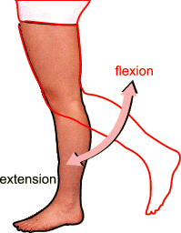

Slide 38
Dorsal flexion: moving the foot towards the tibia (shin)
Plantar flexion: moving the foot away from the tibia. Ex) standing on your toes

Slide 39
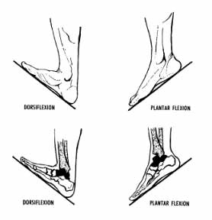

Slide 40
Pronation: twisting the forearm by turning palm face down (when hand is held out front)
Supination: twisting the forearm by turning palm face up (when hand it held out front)

Slide 41
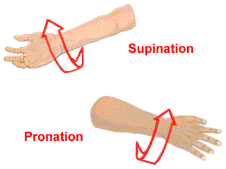

Slide 42
Horizontal adduction: movement of humerus from side-horizontal to front-horizontal Ex) pushing a barbell during a bench press
Horizontal abduction: movement of humerus from front-horizontal to side-horizontal Ex) rowing a boat

Slide 43
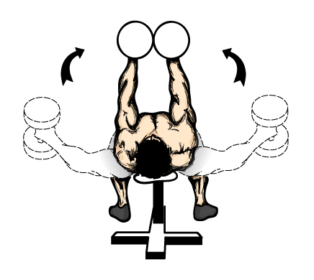
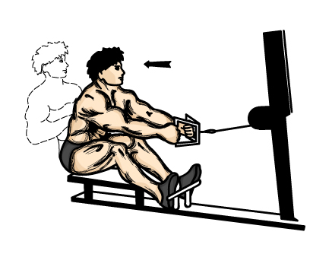
Horizontal adduction
Horizontal abduction

Slide 44
Elevation: movement upward Ex) shrugging the shoulders
Depression: movement downward

Slide 45
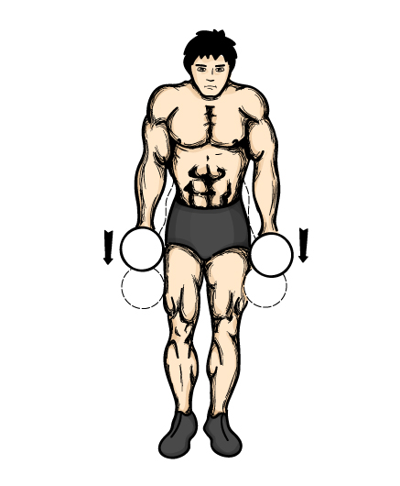
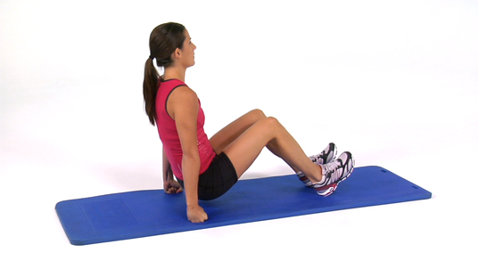
Elevation
Depression

Slide 46
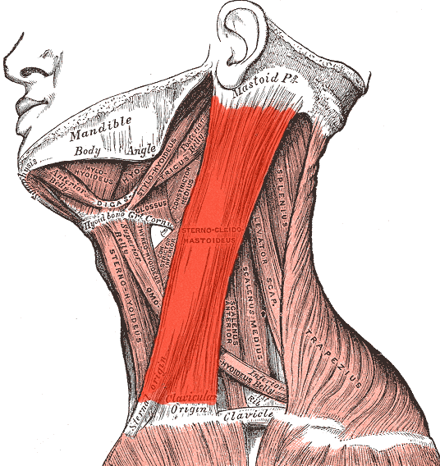
Sternocleidomastoid muscle
is a paired muscle in the
superficial layers of the
anterior portion of the neck.
It acts to flex and rotate the head.
It originates at the sternum and
clavicle; and inserts in the mastoid
process.

Slide 47
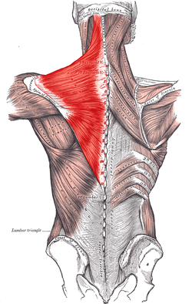
Trapezius muscle
the trapezius is a large superficial muscle that extends longitudinally from the occipital bone to the lower thoracic vertebrae and laterally to the spine of the scapula (shoulder blade).
Functions are to move the scapulae and support the arm.
The trapezius has three functional regions: the superior region (descending part), which supports the weight of the arm; the intermediate region (transverse part), which retracts the scapulae; and the inferior region (ascending part), which medially rotates and depresses the scapulae.

Slide 48
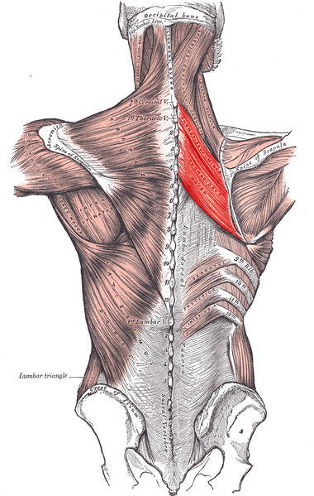
Rhomboid muscle
often simply called the rhomboids,
are rhombus-shaped muscles
associated with the scapula and
are chiefly responsible for its retraction.

Slide 49
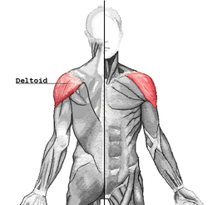
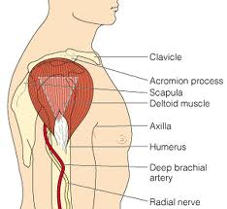
Deltoid muscle
Back view
The deltoid muscle is the
muscle forming the rounded
contour of the shoulder. The
deltoid is the prime mover of
arm abduction along the frontal
plane. The deltoid muscle also
helps the pectoralis major in
shoulder flexion and the latissimus
dorsi in shoulder extension.
Front view
Side view

Slide 50
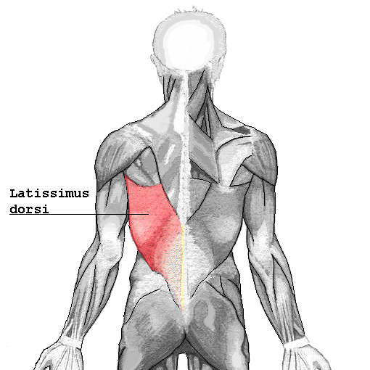
Latissimus dorsi muscle
is the larger, flat, dorso-lateral muscle
on the trunk, posterior to the arm, and
partly covered by the trapezius on its
median dorsal region. It adducts,
extends and internally rotates the arm.

Slide 51
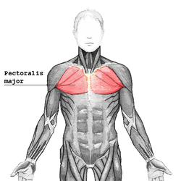
Pectoralis major muscle
is a thick, fan-shaped muscle,
situated at the chest (anterior)
of the body. It makes up the bulk
of the chest muscles in the male
and lies under the breast in the female.
Actions: flexes the chest, extends
the humerus. As a whole, adducts and
medially rotates the humerus.

Slide 52
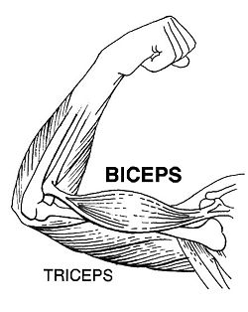
Biceps brachii muscle
is a muscle located on the upper arm.
The term biceps brachii is a Latin phrase
meaning "two-headed [muscle] of the arm",
The biceps has several functions,
the most important being to rotate
the forearm (supination) and to
flex the elbow.

Slide 53
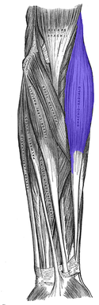
Brachioradialis
is a muscle of the forearm that
acts to flex the forearm at the
elbow. It is also capable of both
pronation and supination, depending
on the position of the forearm.

Slide 54
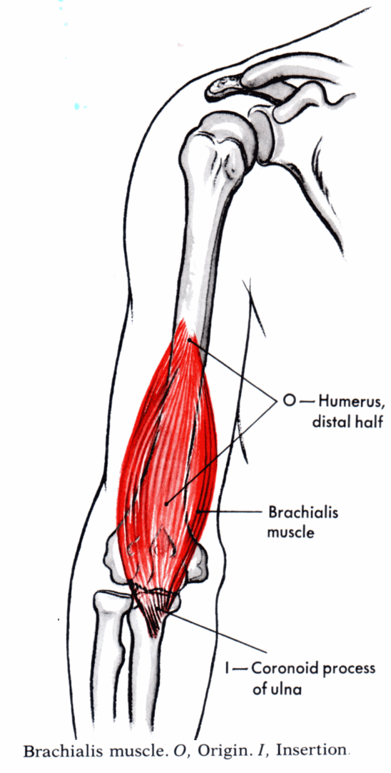
Brachialis
The brachialis is the
Strongest flexor of the
elbow. Unlike the biceps,
the brachialis does not
insert on the radius, and
therefore cannot participate
in pronation and supination
of the forearm.

Slide 55
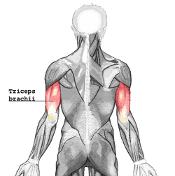
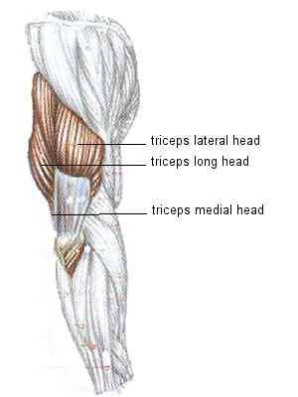
Triceps brachii muscle
The triceps brachii muscle
(Latin for "three-headed arm muscle")
is the large muscle on the back of the
upper limb of many vertebrates. It is
the muscle principally responsible
for extension of the elbow joint
(straightening of the arm).

Slide 56
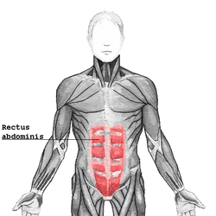
Rectus abdominis muscle
is a paired muscle running vertically
on each side of the anterior wall of
the human abdomen. There are two
parallel muscles, separated by a midline
band of connective tissue called the
linea alba (white line). The rectus is
usually crossed by three fibrous bands.
The rectus abdominis is an important
postural muscle. It is responsible for
flexing the lumbar spine, as when
doing a "crunch".

Slide 57
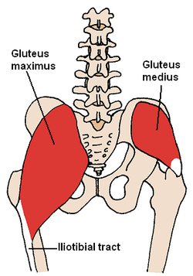
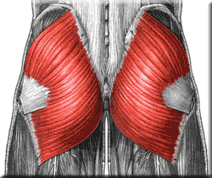
Gluteus maximus muscle
The gluteus maximus is the largest
and most superficial of the three
gluteal muscles. It makes up a large
portion of the shape and appearance
of the buttocks. Its large size is one of
the most characteristic features of the
muscular system in humans, connected
as it is with the power of maintaining the
trunk in the erect posture. The gluteus
maximus extends the femur and brings the
bent thigh into a line with the body.

Slide 58
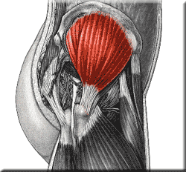
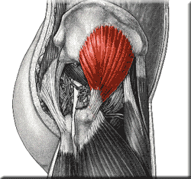
Gluteus Medius and Gluteus Minimus
With the leg in neutral (straightened),
the gluteus medius and gluteus minimus
function together to pull the thigh away
from midline, or "abduct" the thigh. Helps
balance the body on one leg when walking.

Slide 59
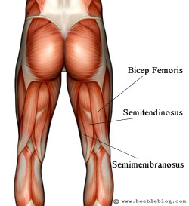
Hamstring
the hamstring refers to posterior thigh
muscles, the semitendinosus, the
semimembranosus and the
biceps femoris. The hamstrings cross
and act upon two joints –
the hip and the knee.
Semitendinosus and semimembranosus
extend the hip when the trunk is fixed;
they also flex the knee and medially
(inwardly) rotate the lower leg when
the knee is bent.
The long head of the biceps femoris
extends the hip as when beginning to
walk; both short and long heads flex
the knee and laterally (outwardly)
rotates the lower leg when the knee is bent.
The hamstrings play a crucial role in
many daily activities, such as, walking,
running, jumping, and controlling some
movement in the trunk. In walking,
they are most important as an
antagonist to the quadriceps in the
deceleration of knee extension.

Slide 60
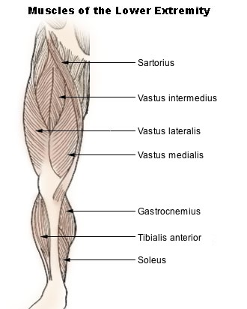

Quadriceps
is a large muscle group that includes
the four prevailing muscles on the front
of the thigh. It is the great extensor muscle
of the knee, forming a large fleshy mass
which covers the front and sides of
the femur. It is the strongest and leanest
muscle in the human body. It is made up
the vastus intermedius, vastus lateralis,
vastus medialis, and rectus fermoris.
All four quadriceps are powerful
extensors of the knee joint. They
are crucial in walking, running,
jumping and squatting. Because
rectus femoris attaches to the ilium, it is
also a flexor of the hip.

Slide 61

Sartorius muscle
The Sartorius muscle – the longest
muscle in the human body – is a long
thin muscle that runs down the length
of the thigh. Assists in flexion, abduction
and lateral rotation of hip, and extension
of knee. Looking at the bottom of one's
foot, as if checking to see if one had
stepped in gum, demonstrates all 4
actions of sartorius.

Slide 62

Tibialis anterior
is a muscle that originates in the
upper two-thirds of the lateral surface
of the tibia and inserts into the medial
cuneiform and first metatarsal bones
of the foot. Its acts to dorsiflex and
invert the foot.

Slide 63

Gastrocnemius
is a very powerful superficial pennate
muscle that is in the back part of the
lower leg. It runs from its two heads
just above the knee to the heel, and
is involved in standing, walking, running
and jumping. Along with the soleus
muscle it forms the calf muscle. Its
function is plantar flexing the foot at
the ankle joint and flexing the leg at
the knee joint.

Slide 64

Soleus
is a powerful muscle in the back
part of the lower leg (the calf). It
runs from just below the knee to
the heel, and is involved in standing
and walking. The action of the
calf muscles, including the soleus,
is plantarflexion of the foot.

Slide 65
Muscular Disorders

Slide 66
Muscular Dystrophy
Muscular dystrophy (MD) is a group of rare inherited muscle diseases in which muscle fibers are unusually susceptible to damage.
Muscles, primarily voluntary muscles, become progressively weaker. In the late stages of muscular dystrophy, fat and connective tissue often replace muscle fibers. In some types of muscular dystrophy, heart muscles, other involuntary muscles and other organs are affected.
The most common types of muscular dystrophy appear to be due to a genetic deficiency of the muscle protein dystrophin.
There's no cure for muscular dystrophy, but medications and therapy can slow the course of the disease.

Slide 67
M.D. Types
1 in 3000 Boys. Females are rarely affected, but often carriers
There are nine major types of MD affecting people of all ages, from infancy to middle age or later. The two most common types of MD affect children:
Duchenne muscular dystrophy (DMD) - most common in children. Usually first seen in boys 2-5 years of age. Most die in their late teens
Becker muscular dystrophy (BMD) - Generally affects older boys and young men, and progresses more slowly. Usually can walk well into adultood
Myotonic dystrophy
produces stiffness of muscles and an inability to relax muscles at will (myotonia), as well as the muscle weakness of the other forms of muscular dystrophy.
Although this form of MD can affect children, it often doesn't affect people until adulthood. It can vary greatly in its severity. Muscles may feel stiff after using them. Progression of this form of MD is slow.

Slide 68
Signs and symptoms
They vary according to the type of muscular dystrophy. In general, they may include:
Muscle weakness
Apparent lack of coordination
Progressive crippling, resulting in contractures of the muscles around your joints and loss of mobility
Many specific signs and symptoms vary from among the different forms of MD. Each type is different in the age of onset, what parts of the body the symptoms primarily affect and how rapidly the disease progresses.

Slide 69


Slide 70

X-linked recessive inheritance pattern with carrier mother
Duchenne and Becker's muscular dystrophies are passed from mother to son through one of the mother's genes in a pattern called X-linked recessive inheritance. Boys inherit an X chromosome from their mothers and a Y chromosome from their fathers. The X-Y combination makes them male. Girls inherit two X chromosomes, one from their mothers and one from their fathers. The X-X combination determines that they are female.

Slide 71

Autosomal dominant inheritance pattern
Patterns differ for other types of MD
Myotonic dystrophy is passed along in a pattern called autosomal dominant inheritance. If either parent carries the defective gene for myotonic dystrophy, there's a 50 percent chance the disorder will be passed along to a child.

Slide 72
Treatment
There's currently no cure for any form of muscular dystrophy. Research into gene therapy may eventually provide treatment to stop the progression of some types of muscular dystrophy.
Current treatment is designed to help prevent or reduce deformities in the joints and the spine and to allow people with MD to remain mobile as long as possible.
Treatments may include various types of physical therapy, medications, assistive devices (braces) and surgery.

Slide 73
Fibrodysplasia ossificans progressiva

Slide 74
Fibrodysplasia ossificans progressiva
Stone Man Syndrome
Extremely rare disease of connective tissue
A mutation of the body’s repair mechanism causes fibrous tissue (muscle, tendon, ligament) to be ossified when damaged.
In some cases, injuries can cause joints to become permanently frozen in place.
The gene that causes ossification is normally deactivated after a fetus' bones are formed in the womb, but in patients with FOP, the gene keeps working.

Slide 75

Symptoms
  Deformed big toes
  Flare up usually occurs before the age of 10
  Deformation begins in the neck and runs down through the body
  Tumor-like lumps appear suddenly
  Often misdiagnosed as cancer or fibrosis because it is so rare

Slide 76

Treatment
No cure
Attempts to remove the bone result in more robust bone growth
Activities that increase the risk of falling should be avoided
Injuries provoke bone growth

