Slide 1
Vascular Plants (vs. Non-Vascular)
Unit 5 – Plant Anatomy, Growth & Function
Mr. Tsigaridis

Slide 2
Plants
Non-vascular (ex. moss)
Vascular (ex. tree, sunflower)
Cannot transport foot or water between plant parts
Transport of fluid is through simple absorption or osmosis
Contain a vascular system allowing for transportation of nutrients / water throughout the plant
Must live in moist environments; need water for reproduction

Slide 3
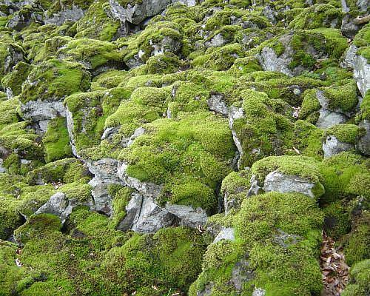
Non-Vascular Plants
Cannot transport food or water between plant parts
Transport of fluid is through simple absorption or osmosis
Must live in moist environments; need water for reproduction
Typically very short and low to the ground for constant water supply

Slide 4
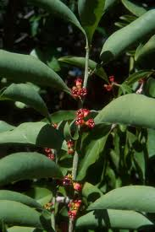
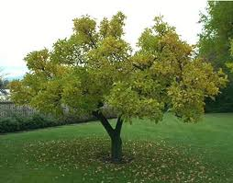
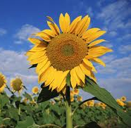
Vascular Plants
Contain a vascular system allowing for transportation of nutrients / water throughout the plant, similar to blood vessels
Typically grow taller than non-vascular plants (complete with stems, larger leaves) because water and nutrients can be conducted upwards

Slide 5
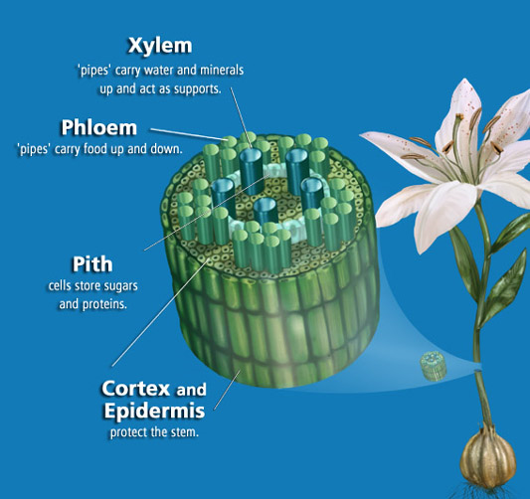
Vascular Tissue in Plants
Instead of arteries, veins and capillaries, plants have two types of vascular tissue in stems:
Xylem → transports water and dissolved minerals
Phloem → transports sugars and proteins (food!) through stem
Cambium → layers of cells between xylem and phloem that are able to divide
Filler & protective cells

Slide 6
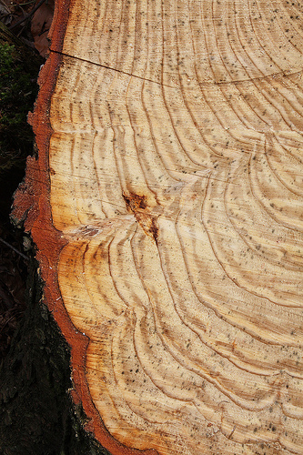
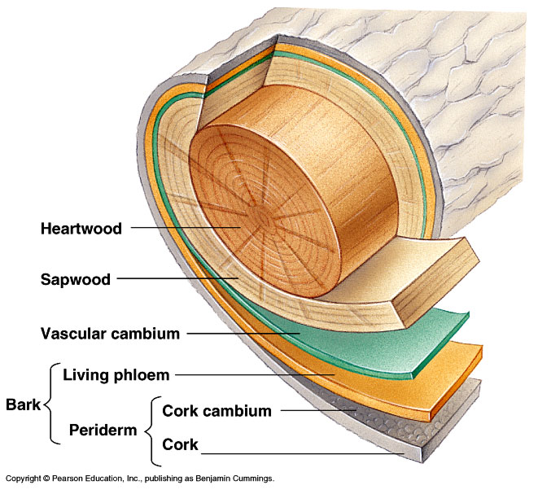
Vascular Cambium
Vascular cambium forms a continuous cylindrical layer inside the stem that can reproduce
Vascular cambium cells divide to form new xylem cells towards the inside of the stem and new phloem toward the outside of the stem
Form tree rings

Slide 7
Gymnosperms
Angiosperms
“Naked seeds” are not enclosed in an ovule (like a pine cone).
Plants are usually evergreens.
Ex. pines, cedars, spruces and firs.
Mature seed is surrounded by the ovule (so produces fruit and/or flowers).
Angiosperms are trees that shed leaves every autumn.
Ex. Oaks, maples and dogwoods are examples of deciduous trees.
VASCULAR PLANTS
Cannot transport foot or water between plant parts
Transport of fluid is through simple absorption or osmosis
Must live in moist environments; need water for reproduction
http://dendro.cnre.vt.edu/forsite/idtype.htm

Slide 8
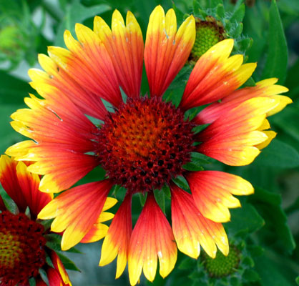
Quiz Time: Which Type Has Flowers?
Gymnosperms or angiosperms???
ANGIOSPERMS!

Slide 9
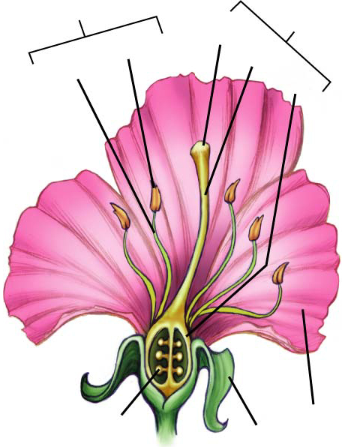
Structure of a Flower
Stamen
Pistil
Stigma
Anther
Style
1.Pistil: female reproductive structure
Stigma: sticky tip; traps pollen
Style: slender tube; transports pollen from stigma to ovary
Ovary: contains ovules; ovary develops into fruit
Ovule: contains egg cell which develops into a seed when fertilized
Filament
Ovary
Petal
Ovule
Sepal

Slide 10
Structure of a Flower
Stamen
Pistil
Stigma
Anther
Style
Stamen: male reproductive structure
Filament: thin stalk; supports anther
Anther: knob-like structure; produces pollen
Pollen: contains microscopic cells that become sperm cells
Filament
Ovary
Petal
Ovule
Sepal

Slide 11
Structure of a Flower
Stamen
Pistil
Stigma
Anther
Style
Sepals: encloses & protects flower before it blooms
Petals: usually colorful & scented; attracts pollinators
Filament
Ovary
Petal
Ovule
Sepal

Slide 12
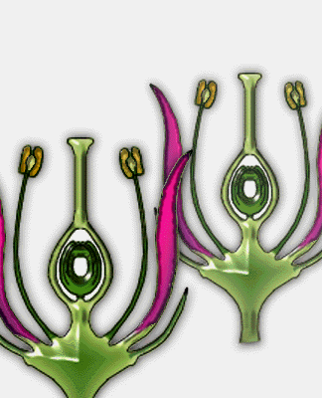
Cross-Pollination
How does pollination happen?
Pollen from an anther is caught by the stigma, travels through style to the ovules in the ovary.
What is the result of pollination?
A Fruit: An ovary containing seeds.

Slide 13
Breaking It Down Further...
Angiosperms
Monocot
One embryonic leaf (cotyledon) when seed germinates
Dicot
Two embryonic leaves (cotyledons) when seed germinates

Slide 14
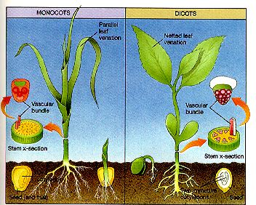
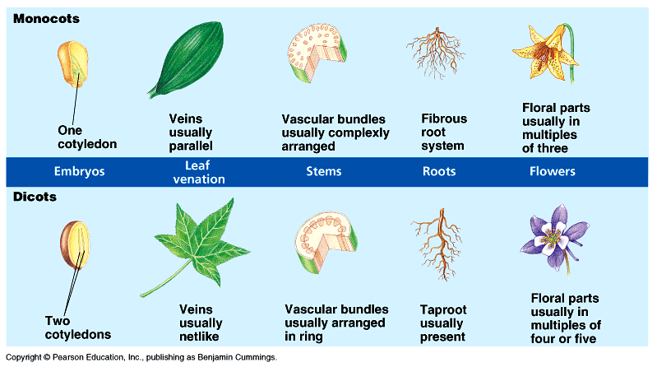
Monocots vs. Dicots
Two types of angiosperms

Slide 15
Monocot vs. Dicot Vascular Tissue
Monocot
Vascular bundles are not arranged in a circle, but are usually scattered throughout the ground tissue. There is no clearly defined pith as there is in many dicot species.
The xylem orientated towards the middle of the stem and the phloem towards the outside.
Dicot
Vascular bundles are arranged in a circle in the middle of the stem surrounding a central pith. To the outside of the vascular bundles is the cortex which is covered by a single layer of epidermis cells.
The xylem orientated towards the middle of the stem and the phloem towards the outside.

Slide 16
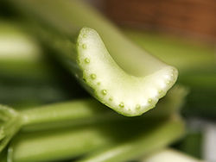
Monocot vs. Dicot Vascular Tissue
Monocot
Dicot
Which one?

Slide 17
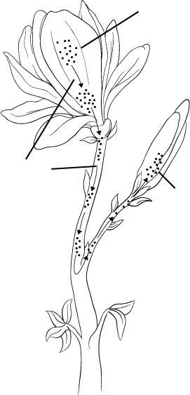
Plant Hormones
Hormone-producing
cells
Plant cells can produce hormones: which are chemical messengers that travel throughout the plant causing other cells called target cells to respond.
In plants, hormones control:
Plant growth & development
Plant responses to environment
Movement
of hormone
Target
cells
Cells in one blooming flower signals other blooms using hormones to open.

Slide 18
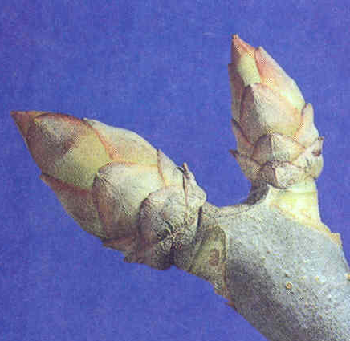
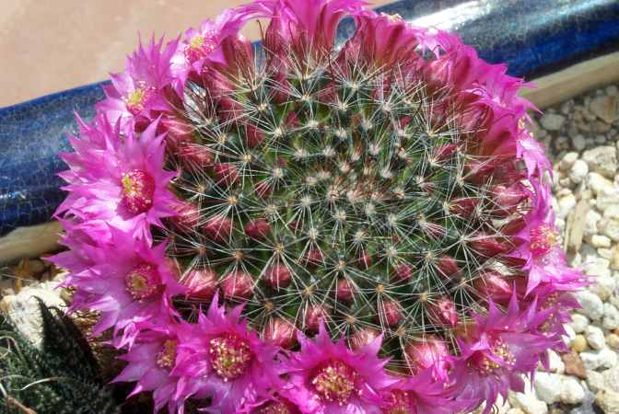
Plants Send Hormone Signals To Each Other To Tell Each Other When To:
When trees to drop their leaves.
When to start new growth.
When to cause fruit to ripen.
When to cause flowers to bloom.
When to cause seeds to sprout.
Leaf Drop
Tree Budding
Fruit
Ripening
Cactus
Blooming
Sprouting
Corn Seeds

Slide 19
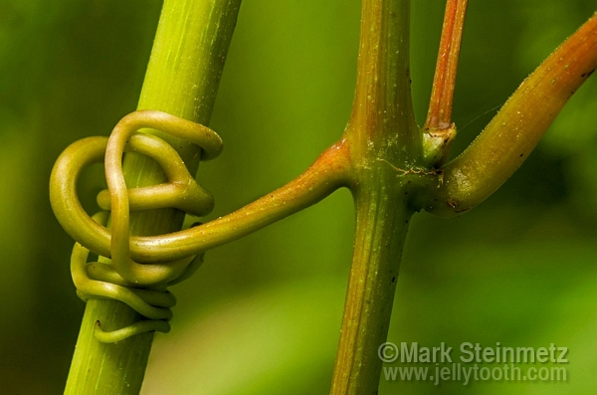
Tropisms
Tropism: the way a plant grows in response to stimuli in the environment.
Phototropism: growth response to light
Positive: Plants bend towards light
Negative: Plants bend away from light
Thigmotropism: growth response to touch
Ex. vines grow up around trees, ticklish plant closes when leaves are touched

Slide 20
Summary of the Plants We Studied:
PLANTS
VASCULAR
NON-VASCULAR
Gymnosperms
Angiosperms
Monocot
Dicot

Slide 21
Key Words: Non-Vascular & Vascular Plants
Non-vascular tissue
Vascular tissue
Xylem
Phloem
Vascular cambium
Monocot
Dicot
Pistil
Stigma
Style
Ovary
Ovule
Stamen
Filament
Anther
Pollen
Sepal
Petal
Pollination
Cotyledon
Hormones
Target cells
Tropism
Phototropism (positive and negative)
Thigmotropism

